Slide 1
Regional Analysis
File created on: 10-07-2023 14:02:38

Slide 2
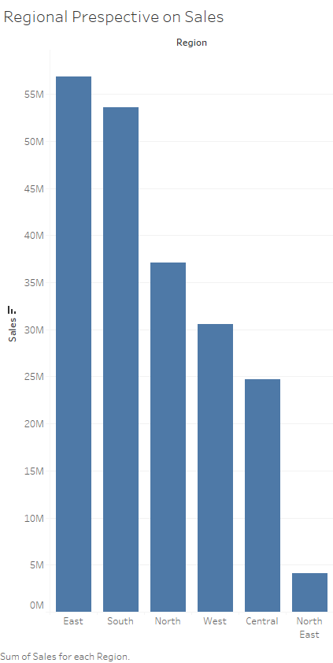

Slide 3
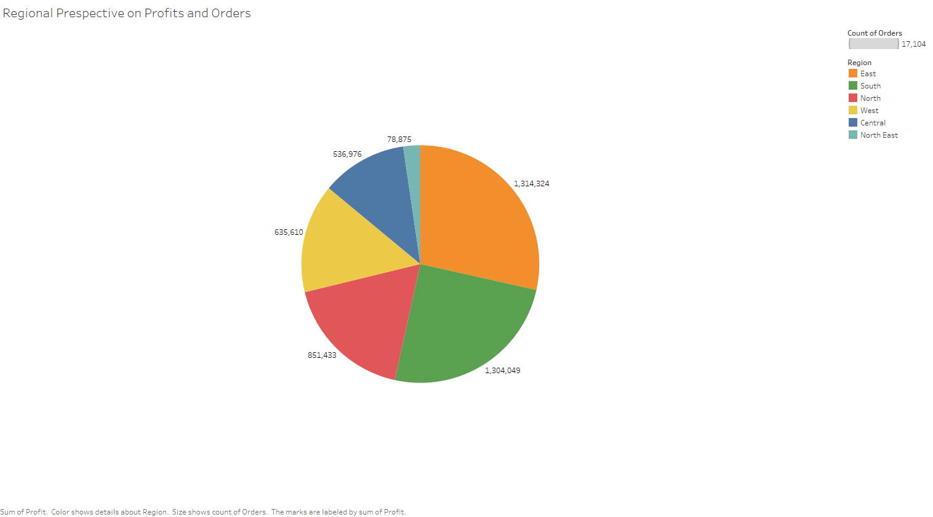

Slide 4
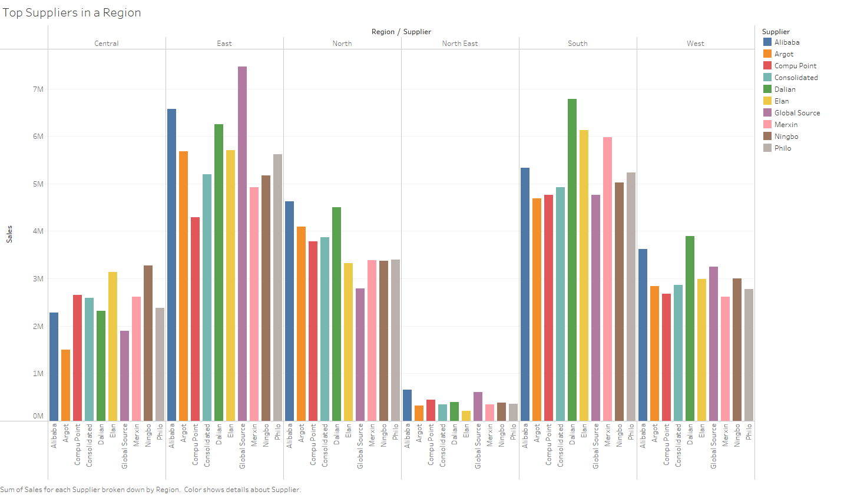

Slide 5
